Slide 1
Why Words Matter.
The importance of using compassionate, respectful language as a health care provider.
Sara Horne - NHATA Edac liaison

Slide 2
Be the change that you wish to see in the world.
- Ghandi
As Athletic Trainer’s, we serve and interact with a large part of our community. It is our job to make sure we are aware of things we say and do that can be offensive or inappropriate to our patient population.
Research has shown the AT’s and ATS’ have high levels of cultural awareness, but desire cultural skills like communication.

Slide 3
Pobody is Nerfect
Although we are proven to be more culturally competent, it is more like an AT can unknowingly offend or use an inappropriate phrase when around patients.
The last thing we want to do is offend or insult someone, however intent and perceptions are different things.
Some patients can perceive our words or actions differently than intended to.

Slide 4
Intention vs. Perception
We need to provide care that is respectful of and responsive to individual patient preferences, needs, and values.
Words can have an everlasting effect.
If your patient feels unwelcome or marginalized, intention does not matter.
Excuses for intentions also tend to take focus away from the hurt party. There is no justification that will make that patient feel better about the interaction.

Slide 5
Things to Avoid
Avoid gender-related and sex terms to insult someone or make a joke. (“you throw like a girl”)
Don’t use words to demean, insult or ridicule religion, socioeconomic class, or gender. (“Ghetto”)
Avoid terms that insult or praise someone based on racial or ethnic stereotypes. (“You speak so well”).
Don’t use homophobic epithets, words or sayings that insult s LGBTQ+ identities. (“that’s so gay”)
Don’t use insulting words or terms related to physical or mental impairments or to describe individuals with a disability. Use person first language. (“Slow”, “lame”)
Avoid slang if you don’t know the meaning or origin of the saying.
Apologize with compassion, not sarcasm.

Slide 6
Respectful Regrets
Acknowledge that some patients may have a different perception of your words.
Be aware of body language and facial responses to your words.
Apologize. Don’t shy away from the interaction, address it while you can.
Listen to your patients response and learn from it.
Learn why and how what you said can be offensive.
Reflect on the situation after it occurs. Put yourself in someone else’s shoes.
Do better. Think twice about what you’re saying.

Slide 7
Using Compassionate Language
Words or phrases that may be offensive or potentially harmful to a patient varies from people’s views or culture.
Like people, these words or phrases an evolve overtime.
These is no reference books of offensive words, so it is our job to become more aware of your word choice and take action when you make a mistake.

Slide 8
Be Compassionate.
Athletic trainer’s can act as mentor’s too athletes or ATS’, it is important that we pass our compassionate and culturally competent care down to them.
The chances are high that we will accidentally offend someone at one point. Nobody is perfect.
Remember if you offend do not defend. Accept that you may have offended this patient and learn from the interaction.
Responding gracefully and learning from the situation can help us become and provide more compassionate care to our patients.

Slide 9
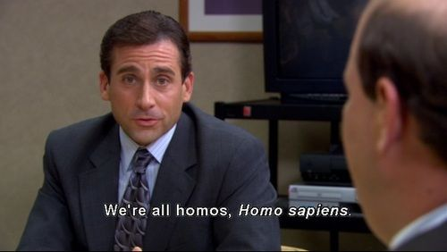
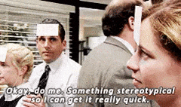
Don’t Be Michael Scott.
OR Dwight…

