Slide 1
Addressing Implicit Bias and Micro-aggressions
“I don’t have any bias’, I treat all my athlete’s the same!”
Sara Horne

Slide 2
What is bias?
Bias is defined as the negative evaluation of one group and its members relative to another.
Explicit bias is when a person is aware of his and/or her evaluation of a group and believes that evaluation is accurate.

Slide 3
Implicit Bias
Implicit or Unconscious Bias does not require an individual to be aware of their evaluations of a certain group and operates in an unintentional and unconscious form.
Implicit bias in health care may directly lead to health care inconsistencies and it is important for health care workers to be aware of these biases, as they can directly effect the care provided and received.

Slide 4
Specific Vulnerable Populations
- Minority ethnic populations
- Immigrants
- The poor
- Low health-literacy individuals
- Sexual minorities
- Children
- Women
- The Mentally ill
- The overweight
- The Disabled
- The Elderly
- LGBTQ+ Community
Examples of Implicit Bias in Health Care
Non-white patients receive fewer cardiovascular interventions.
Black women are more likely too die after being diagnosed with breast cancer.
Patients of color are more likely to be blamed for being passive with their health care.

Slide 5
What is a Micro-
Aggression?
brief and commonplace daily verbal, behavioral, and environmental indignities, whether intentional or unintentional, that communicate hostile, derogatory or negative racial slights and insults to the target person or group. (Defined by University of Washington racial equity glossary)
In other words a Sometimes a subtle, well-intentioned comment or question that can negatively impact patient compliance and/or care when they are committed by HCP’s.

Slide 6
So what does that Mean?
Subtle well-intentioned comment or question that can negatively impact the patient compliance and/or care when committed by health care providers.
These can be verbal/non-verbal, intentional/unintentional, or unconsciously harmful
Examples of microaggressions include:
“Lighten up”
“I didn’t mean it like that”
“Your name is too hard to pronounce, can I call you something else”
“You’re so articulate”

Slide 7
4 Types of Microaggressions
Microassaults and environmental microaggressions
Most common types committed in health care settings are microinsults and microinvalidaltions
Microinsults
Often unintentional, insensitive or demeaning actions aimed at racial identity or cultural heritage
“You are so well spoken”
“You dress so appropriately
Gives patient message they are varying from cultural norm
Microinvalidaltions
Exclusive in nature to dismiss thoughts, feelings, or experiences of people of color
Ignores patients race/culture and the impact it could have on their health care

Slide 8
How MicroAggressions effect patients and Patient outcomes
After encountering a microaggression, patients can manifest reactions in a physical, psychological, or mental displays.
Physical reactions can include;
GI problems
Hypertension
Increased heart rate or respirations
Mental reactions can make a patient feel;
Isolated
Betrayed
Anxious
Depressed
Angry
Tense

Slide 9
Coping Strategies for patients
Use laughter as a mask for pain or embarrassment
Ignore it
Offer a “pass” for the offender by making an excuse
Begin avoiding offender
This is when is begins to negatively impact patient compliance and treatment.
Be aware in changes in body language to understand discontent from patient
Help to identify when microaggression occurred
“Are you okay, did I say or do something to offend you”
Be open to hear what patient has to say and try not to become defensive
Apologize, learn, and do not repeat

Slide 10
Avoiding MicroAggressions
Be open to realize that they occur and be willing to learn what they are, when/where they can happen, and how they can impact the patient.
The most uncomfortable part about the process is recognizing that we all have impact biases, or prejudices
Don’t be hesitant to recognize these biases and confront them.
Hold anti-racism training at your facility
Address levels of individual/institutional issues can help shape health care workers
Establish a white ally to serve as a support system
Important to be vocal and active
Typically in a position of leadership and/or authority
Can be pivotal in decision-making to have systematic change within the institution

Slide 11
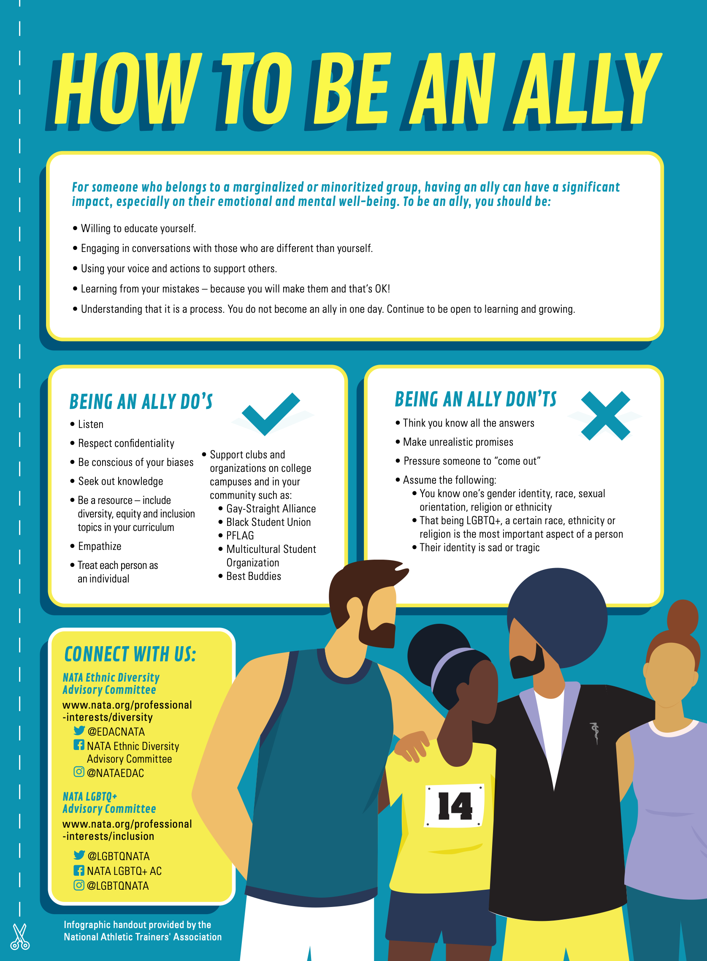
We are advocates.
It is important to be aware and recognize your role as an advocate for these patients
Acknowledge resources for patients
School counselor or mental health center
Helps to improve ability to continue treating patients after the experience occurs.
Be aware of the impact that color, gender, and cultural backgrounds has on a patients care
Raise awareness
Voice concerns
Constructively confront microaggressions
Continue education in culturally competent care and behavior

Slide 12
Resources
News Magazine of NATA - November 2020 “The Human Side of Health Care”
“Small But Mighty” by Claire Higgins
“Understanding Implicit Bias in Health Care” NATA Blog - by JordanG
https://www.nata.org/blog/jordan-grantham/understanding-implicit-bias-health-care

